Slide 1
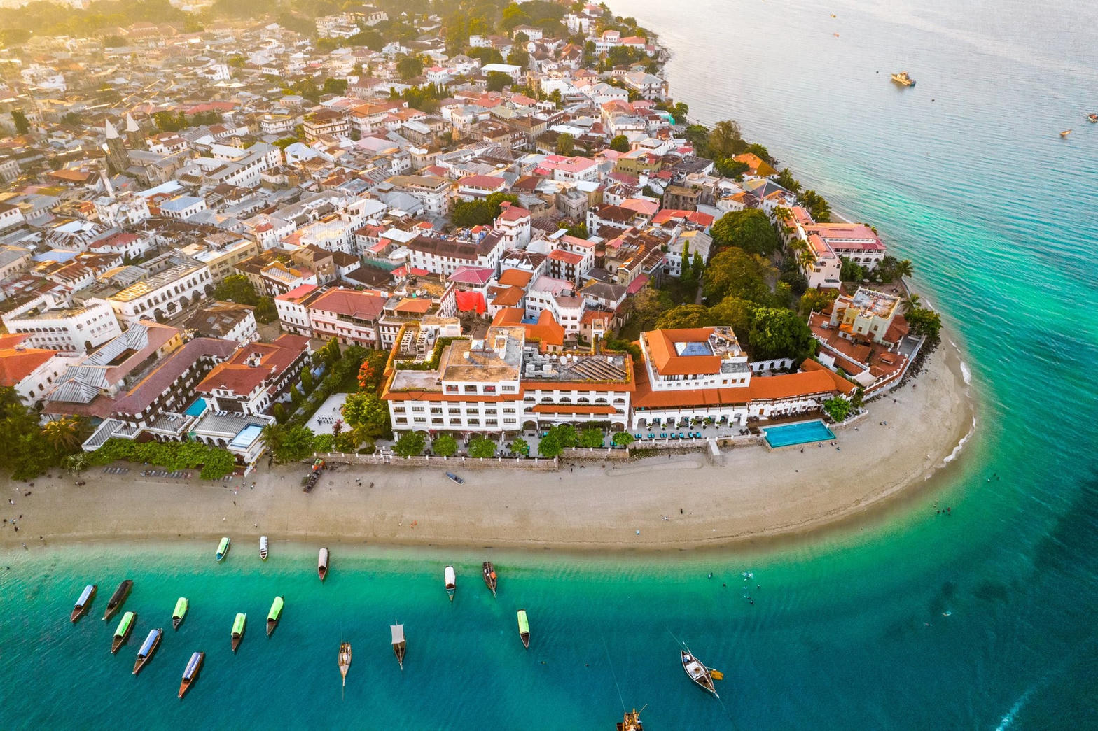
MARKET PACK · WAVE 4 · PAIRED WITH DAR
A jurisdiction.
Not an island listing.
Stone Town, Nungwi, hospitality supply chain.
Wedge: 99-year / condominium literacy + hotel FF&E logistics.
Real Estate Africa SA Logistics · Zanzibar · Confidential
1 / 10

Slide 2
WHY
Why Zanzibar is on the 2027 map
– Land law is not mainland Tanzania. Treating it as such is a product bug.
– Hospitality fit-out and villa supply is the logistics SKU, not household sofas.
– Diaspora and GCC buyers. Card and USD dual price first.
Real Estate Africa SA Logistics · Zanzibar · Confidential
2 / 10

Slide 3
LAW ON THE CARD
Tenure language we will actually print
– Separate land regime. 99-year leases and condominium structures are the default language.
– Foreign ownership screens — flag, do not promise.
– Heritage constraints in Stone Town. Photo is not permission to alter.
– Never copy-paste Uganda occupant fields onto ZNZ cards.
Not legal advice. Local counsel on every close.
Real Estate Africa SA Logistics · Zanzibar · Confidential
3 / 10

Slide 4
GEOGRAPHY
Where we spend — and where we wait
Zone | Role | Wave
Stone Town | Heritage houses, hospitality | Jul 2027
Nungwi / North | Villa + hotel supply | Jul 2027
Airport / Fumba | Logistics inbound | Aug 2027
Real Estate Africa SA Logistics · Zanzibar · Confidential
4 / 10

Slide 5
CHANNELS
How this market hears us
– Hotel GM and procurement WhatsApp, not only brokers.
– Instagram/Facebook for villa demand; LinkedIn for FF&E freight.
– English + Swahili. Arabic captions for GCC diaspora only after Wave 4 week 4.
– Pair every ZNZ ad with a Dar freight SLA — island without a ship is a postcard.
Real Estate Africa SA Logistics · Zanzibar · Confidential
5 / 10

Slide 6
SCOREBOARD
Targets after spend opens
KPI | 90 days | Note
Paying seats | 40 | Hospitality-weighted
Live listings | 60 | Tenure field 100%
FF&E / villa supply quotes | 20 | The SKU
Dar pairing | Every quote | No island-only freight
Real Estate Africa SA Logistics · Zanzibar · Confidential
6 / 10

Slide 7
OFFER
What we push first
Demand
Supply
– Buyer Explore free — fill the top of funnel.
– Diaspora Plus $10 — remote buyers.
– Enterprise $199 only where a developer is named.
– Agent Starter $9 until the room is used to us.
– Agency Pro $49 as the default agency seat.
– Logistics Partner $69 where a corridor exists.
Real Estate Africa SA Logistics · Zanzibar · Confidential
7 / 10

Slide 8
HOLD
Do not
– Do not run Zanzibar as a Tanzania filter. Do not skip freight on villa ads.
– Do not invent a second brand film.
– Do not discount the public price card.
– Do not go live on a listing with empty tenure.
Real Estate Africa SA Logistics · Zanzibar · Confidential
8 / 10

Slide 9
PAIRING
Always ship with a move
– Every featured listing has a freight or household quote path.
– Corridor stories beat city pride: Kampala–Malaba, Mombasa–Kampala, Dar–Kigali, lake.
– SLA: quote in < 4 hours in the live city, < 1 business day otherwise.
Real Estate Africa SA Logistics · Zanzibar · Confidential
9 / 10

Slide 10

CLOSE
Zanzibar.
Precise, or not at all.
Real Estate Africa SA Logistics · sharp@realsalogistics.com · @realsalogistics
Real Estate Africa SA Logistics · Zanzibar · Confidential
10 / 10

