Slide 1
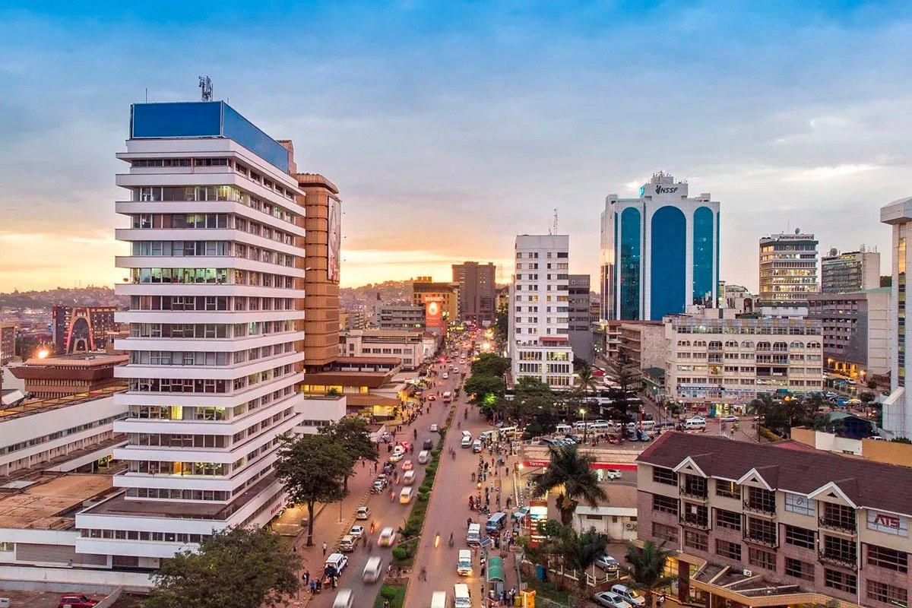
MARKET PACK · LIVE
Uganda is the
operating system.
Kampala Wave 1 (Feb 2027), then Entebbe, Jinja, Mbarara in March–April.
Wedge: mailo occupant + buyout. Payments: MTN MoMo, Airtel, card.
Real Estate Africa SA Logistics · Uganda · Confidential
1 / 10

Slide 2
WHY
Why Uganda is on the 2027 map
– Headquarters posture. Every other market copies this desk.
– Mailo dual-estate is a real due-diligence gap. Portals ignore it.
– Household move + warehouse on Entebbe Road is the logistics proof.
Real Estate Africa SA Logistics · Uganda · Confidential
2 / 10

Slide 3
LAW ON THE CARD
Tenure language we will actually print
– Tenure on platform: mailo, freehold, leasehold.
– Occupant class: lawful / bona fide / none — Land Act ss.29–38 language, not slang.
– Buyout: willing-buyer/willing-seller, first option, surrender, mutation, spousal consent.
– Foreign buyers: use counsel. Do not advertise unrestricted ownership.
Not legal advice. Local counsel on every close.
Real Estate Africa SA Logistics · Uganda · Confidential
3 / 10

Slide 4
GEOGRAPHY
Where we spend — and where we wait
City | Role | Wave
Kampala | Launch, brand, mailo wedge | Feb 2027
Entebbe | Airport warehouses, household inbound | Mar 2027
Jinja | Residential + Nile corridor | Apr 2027
Mbarara | Western depth | Apr 2027
Gulu | Hold until 200 paying Uganda seats | Later
Real Estate Africa SA Logistics · Uganda · Confidential
4 / 10

Slide 5
CHANNELS
How this market hears us
– WhatsApp Business as CRM.
– Capital, KFM, CBS — 15s, Wave 1 only.
– Outdoor: Yusuf Lule, Entebbe Rd, Northern Bypass.
– Broker and valuer rooms — not generic mixers.
Real Estate Africa SA Logistics · Uganda · Confidential
5 / 10

Slide 6
SCOREBOARD
Targets after spend opens
KPI | 90 days | 180 days
Paying seats | 250 | 500
Live listings | 400 | 900
Logistics quotes | 80 | 200
MoMo success | 92%+ | 94%+
Real Estate Africa SA Logistics · Uganda · Confidential
6 / 10

Slide 7
OFFER
What we push first
Demand
Supply
– Buyer Explore free — fill the top of funnel.
– Diaspora Plus $10 — remote buyers.
– Enterprise $199 only where a developer is named.
– Agent Starter $9 until the room is used to us.
– Agency Pro $49 as the default agency seat.
– Logistics Partner $69 where a corridor exists.
Real Estate Africa SA Logistics · Uganda · Confidential
7 / 10

Slide 8
HOLD
Do not
– Do not spend Kenya before 250 Uganda seats. Do not say 'clean title.'
– Do not invent a second brand film.
– Do not discount the public price card.
– Do not go live on a listing with empty tenure.
Real Estate Africa SA Logistics · Uganda · Confidential
8 / 10

Slide 9
PAIRING
Always ship with a move
– Every featured listing has a freight or household quote path.
– Corridor stories beat city pride: Kampala–Malaba, Mombasa–Kampala, Dar–Kigali, lake.
– SLA: quote in < 4 hours in the live city, < 1 business day otherwise.
Real Estate Africa SA Logistics · Uganda · Confidential
9 / 10

Slide 10

CLOSE
Uganda.
Precise, or not at all.
Real Estate Africa SA Logistics · sharp@realsalogistics.com · @realsalogistics
Real Estate Africa SA Logistics · Uganda · Confidential
10 / 10

