Slide 1
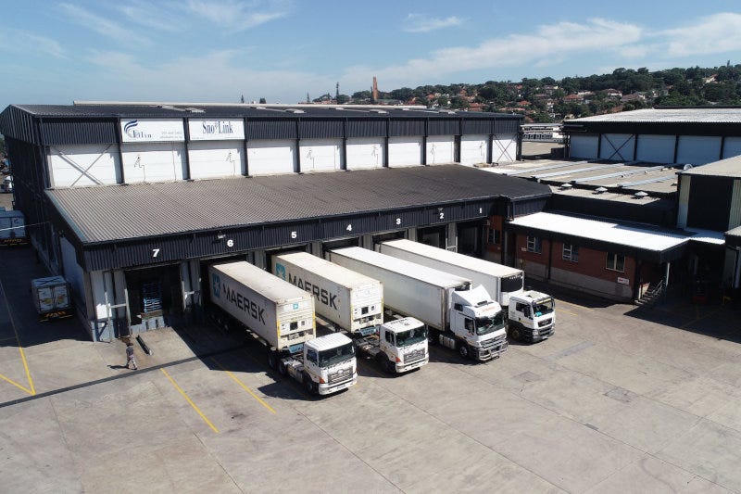
MARKET PACK · WAVE 4 · JULY 2027
Dar is bonded
ground, not freehold.
Open with Zanzibar as a pair — never as a suburb.
Wedge: Granted Right of Occupancy / derivative right + ICD yard.
Real Estate Africa SA Logistics · Tanzania · Confidential
1 / 10

Slide 2
WHY
Why Tanzania is on the 2027 map
– Mainland land is public. Listings that say 'freehold' will get us sued.
– Portside bonded yards and ICDs are the logistics SKU.
– Arusha and Mwanza wait until Dar has 80 live listings.
Real Estate Africa SA Logistics · Tanzania · Confidential
2 / 10

Slide 3
LAW ON THE CARD
Tenure language we will actually print
– Granted Right of Occupancy. Derivative rights for investors.
– Do not use Uganda mailo language on TZ cards.
– Company and local-participation rules — flag for counsel.
– Payments: M-Pesa / card. Test settlement before ads.
Not legal advice. Local counsel on every close.
Real Estate Africa SA Logistics · Tanzania · Confidential
3 / 10

Slide 4
GEOGRAPHY
Where we spend — and where we wait
City | Role | Wave
Dar es Salaam | Port, ICD, residential | Jul 2027
Zanzibar | Separate jurisdiction, paired campaign | Jul 2027
Arusha | Hold | After 80 Dar listings
Mwanza | Lake, hold | After Arusha
Real Estate Africa SA Logistics · Tanzania · Confidential
4 / 10

Slide 5
CHANNELS
How this market hears us
– Agency rooms in Dar. Not a Kampala event with a TZ hashtag.
– Port and freight WhatsApp groups.
– Swahili-first creative. English second.
– No billboard until 40 Dar listings are live.
Real Estate Africa SA Logistics · Tanzania · Confidential
5 / 10

Slide 6
SCOREBOARD
Targets after spend opens
KPI | 90 days post-open | Note
Paying seats | 80 | Dar-weighted
Live listings | 120 | Zero fake freehold
Bonded / ICD quotes | 25 | The SKU
Creative in Swahili | 100% | Hard gate
Real Estate Africa SA Logistics · Tanzania · Confidential
6 / 10

Slide 7
OFFER
What we push first
Demand
Supply
– Buyer Explore free — fill the top of funnel.
– Diaspora Plus $10 — remote buyers.
– Enterprise $199 only where a developer is named.
– Agent Starter $9 until the room is used to us.
– Agency Pro $49 as the default agency seat.
– Logistics Partner $69 where a corridor exists.
Real Estate Africa SA Logistics · Tanzania · Confidential
7 / 10

Slide 8
HOLD
Do not
– Do not advertise freehold. Do not fold Zanzibar into a Tanzania slide in client rooms.
– Do not invent a second brand film.
– Do not discount the public price card.
– Do not go live on a listing with empty tenure.
Real Estate Africa SA Logistics · Tanzania · Confidential
8 / 10

Slide 9
PAIRING
Always ship with a move
– Every featured listing has a freight or household quote path.
– Corridor stories beat city pride: Kampala–Malaba, Mombasa–Kampala, Dar–Kigali, lake.
– SLA: quote in < 4 hours in the live city, < 1 business day otherwise.
Real Estate Africa SA Logistics · Tanzania · Confidential
9 / 10

Slide 10

CLOSE
Tanzania.
Precise, or not at all.
Real Estate Africa SA Logistics · sharp@realsalogistics.com · @realsalogistics
Real Estate Africa SA Logistics · Tanzania · Confidential
10 / 10

