Slide 1
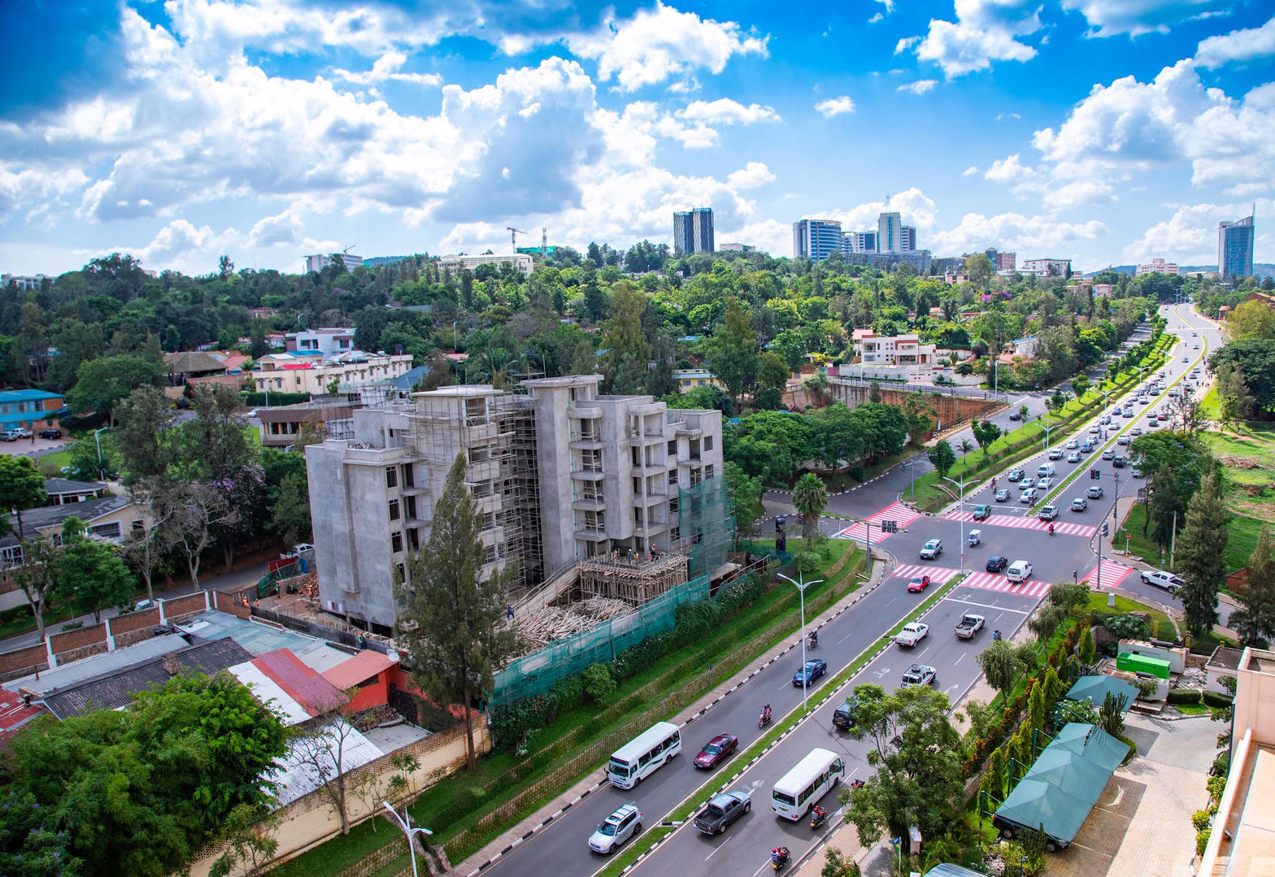
MARKET PACK · WAVE 5 · SEPTEMBER–OCTOBER 2027
Kigali is a
digital registry.
Open spend after Kenya corridor is quoting.
Wedge: UPI-native listings. No analogue title theater.
Real Estate Africa SA Logistics · Rwanda · Confidential
1 / 10

Slide 2
WHY
Why Rwanda is on the 2027 map
– Buyers already expect a Unique Parcel Identifier. Listings without it look unserious.
– Emphyteutic 99-year leases are the residential default language.
– Small geography. Precision beats coverage.
Real Estate Africa SA Logistics · Rwanda · Confidential
2 / 10

Slide 3
LAW ON THE CARD
Tenure language we will actually print
– UPI on every live card. No UPI, no live.
– Emphyteutic lease 99 years — write it, do not translate into freehold.
– Foreign ownership and company tests — flag for counsel.
– Payments: card + MoMo where live. Test before ads.
Not legal advice. Local counsel on every close.
Real Estate Africa SA Logistics · Rwanda · Confidential
3 / 10

Slide 4
GEOGRAPHY
Where we spend — and where we wait
City | Role | Wave
Kigali (Nyarutarama, Kimihurura, Rebero) | Only Wave 5 geography | Sep 2027
Secondary cities | Hold | After 80 Kigali listings
Real Estate Africa SA Logistics · Rwanda · Confidential
4 / 10

Slide 5
CHANNELS
How this market hears us
– Digital-first. LinkedIn and X before radio.
– Agency and notary rooms. Short, numbered one-pagers.
– No outdoor in month 1.
– Kinyarwanda + English. French third.
Real Estate Africa SA Logistics · Rwanda · Confidential
5 / 10

Slide 6
SCOREBOARD
Targets after spend opens
KPI | 90 days | Note
Paying seats | 70 | Kigali only
Live listings with UPI | 100% | Hard gate
Paying seats | 70 | Quality over map
Quotes to Kampala/Nairobi | 15 | Corridor, not island
Real Estate Africa SA Logistics · Rwanda · Confidential
6 / 10

Slide 7
OFFER
What we push first
Demand
Supply
– Buyer Explore free — fill the top of funnel.
– Diaspora Plus $10 — remote buyers.
– Enterprise $199 only where a developer is named.
– Agent Starter $9 until the room is used to us.
– Agency Pro $49 as the default agency seat.
– Logistics Partner $69 where a corridor exists.
Real Estate Africa SA Logistics · Rwanda · Confidential
7 / 10

Slide 8
HOLD
Do not
– Do not list without UPI. Do not use mailo vocabulary. Do not open secondary cities in Wave 5.
– Do not invent a second brand film.
– Do not discount the public price card.
– Do not go live on a listing with empty tenure.
Real Estate Africa SA Logistics · Rwanda · Confidential
8 / 10

Slide 9
PAIRING
Always ship with a move
– Every featured listing has a freight or household quote path.
– Corridor stories beat city pride: Kampala–Malaba, Mombasa–Kampala, Dar–Kigali, lake.
– SLA: quote in < 4 hours in the live city, < 1 business day otherwise.
Real Estate Africa SA Logistics · Rwanda · Confidential
9 / 10

Slide 10

CLOSE
Rwanda.
Precise, or not at all.
Real Estate Africa SA Logistics · sharp@realsalogistics.com · @realsalogistics
Real Estate Africa SA Logistics · Rwanda · Confidential
10 / 10

