Slide 1
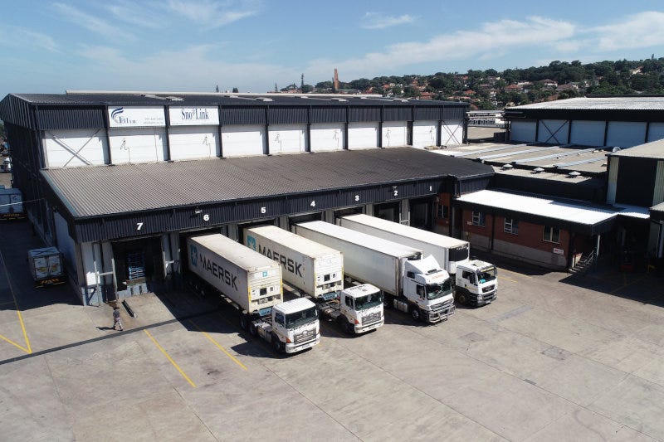
MARKET PACK · WAVE 3 · MAY–JUNE 2027
Nairobi is the
port story.
Open spend only after 250 paying Uganda seats.
Wedge: 99-year lease literacy + Mombasa–Malaba–Kampala freight.
Real Estate Africa SA Logistics · Kenya · Confidential
1 / 10

Slide 2
WHY
Why Kenya is on the 2027 map
– Kenya is not a second Kampala. It is the corridor that makes Uganda logistics true.
– Nairobi agencies already have listing portals. We sell lease hygiene + the move.
– Mombasa ICD and bound cargo is the enterprise door.
Real Estate Africa SA Logistics · Kenya · Confidential
2 / 10

Slide 3
LAW ON THE CARD
Tenure language we will actually print
– Citizens: freehold / leasehold. Non-citizens: leasehold, typically 99 years — say so on the card.
– Sectional properties for apartments. Do not list a section as land.
– Company-shareholding tests for foreign control. Flag, do not opine.
– Pay: M-Pesa first, then card. MoMo is secondary here.
Not legal advice. Local counsel on every close.
Real Estate Africa SA Logistics · Kenya · Confidential
3 / 10

Slide 4
GEOGRAPHY
Where we spend — and where we wait
City | Role | Wave
Nairobi | Agencies, Tatu / industrial | May 2027
Mombasa | Port, ICD, coastal residential | Jun 2027
Kisumu | Lake corridor, hold | After 120 KE seats
Real Estate Africa SA Logistics · Kenya · Confidential
4 / 10

Slide 5
CHANNELS
How this market hears us
– M-Pesa checkout in the first Kenya screenshot.
– LinkedIn + agency associations before radio.
– X for Nairobi; Facebook for diaspora Mombasa families.
– No Kenyan outdoor until 80 Nairobi listings are live.
Real Estate Africa SA Logistics · Kenya · Confidential
5 / 10

Slide 6
SCOREBOARD
Targets after spend opens
KPI | 90 days post-open | Note
Paying seats | 120 | Mix of $9 and $49
Live listings | 200 | Nairobi + Mombasa only
Corridor quotes UG↔KE | 40 | This is the point
M-Pesa success | 93%+ | Hold paid if lower
Real Estate Africa SA Logistics · Kenya · Confidential
6 / 10

Slide 7
OFFER
What we push first
Demand
Supply
– Buyer Explore free — fill the top of funnel.
– Diaspora Plus $10 — remote buyers.
– Enterprise $199 only where a developer is named.
– Agent Starter $9 until the room is used to us.
– Agency Pro $49 as the default agency seat.
– Logistics Partner $69 where a corridor exists.
Real Estate Africa SA Logistics · Kenya · Confidential
7 / 10

Slide 8
HOLD
Do not
– Do not open Kisumu to look national. Do not hide the 99-year lease rule.
– Do not invent a second brand film.
– Do not discount the public price card.
– Do not go live on a listing with empty tenure.
Real Estate Africa SA Logistics · Kenya · Confidential
8 / 10

Slide 9
PAIRING
Always ship with a move
– Every featured listing has a freight or household quote path.
– Corridor stories beat city pride: Kampala–Malaba, Mombasa–Kampala, Dar–Kigali, lake.
– SLA: quote in < 4 hours in the live city, < 1 business day otherwise.
Real Estate Africa SA Logistics · Kenya · Confidential
9 / 10

Slide 10

CLOSE
Kenya.
Precise, or not at all.
Real Estate Africa SA Logistics · sharp@realsalogistics.com · @realsalogistics
Real Estate Africa SA Logistics · Kenya · Confidential
10 / 10

