Slide 1

WAVE 1 · 19 JANUARY – 27 FEBRUARY 2027
Kampala launch.
Week of 2 February.
Dry-season viewings. Post-holiday cash. Pre-Lent calendar.
Creative: the villa film. Wedge: mailo occupant + buyout on every listing.
Real Estate Africa SA Logistics · Kampala launch · Confidential
1 / 12

Slide 2
WHY THIS WEEK
Calendar logic — not a vibe
Date | What it is | Implication
26 Jan 2027 | NRM / public holiday week | Do not launch that Monday
1–7 Feb 2027 | First full working week of February | Launch window
14 Feb 2027 | Noise on consumer media | Keep radio on property, not romance
Mar 2027 | Lent / school rhythm | Move to Entebbe–Jinja depth, not a second city launch
Dec 2026 | Holiday cash leaving town | Private beta only — no paid
Real Estate Africa SA Logistics · Kampala launch · Confidential
2 / 12

Slide 3
NEIGHBOURHOODS
Where the first 80 listings must come from
– Kololo, Naguru, Bukoto — mailo and freehold residential. Photograph tenure, not just the pool.
– Ntinda, Kyanja, Naalya — salaried buyers. Price in UGX and USD.
– Munyonyo / Lake — weekend viewings, diaspora families.
– Industrial Area, Nakawa, Namanve, Entebbe Road — logistics and warehouses. This is half the brand.
– Do not open Gulu or Mbarara in Wave 1. Depth in Kampala beats a map of pins.
Real Estate Africa SA Logistics · Kampala launch · Confidential
3 / 12

Slide 4
AGENTS
Founding 40
Offer
Rules
– 90 days of Agency Pro billed at $9.
– Verified badge after 3 completed viewings.
– Lead inbox on WhatsApp, not email.
– Listing photography day provided for first 15 agents.
– Every live listing needs tenure, occupants, buyout.
– Fake stock = badge revoked.
– Exclusive not required. Accuracy is.
– No second price card. Public prices stand.
Real Estate Africa SA Logistics · Kampala launch · Confidential
4 / 12

Slide 5
CREATIVE
One film, three cuts
– Hero 15s: villa + SUV push-in (already shot). Outdoor still comes from frame 04.
– City 15s: Kampala hills at dusk. Used on X and Facebook.
– Move 15s: truck at dawn + warehouse aisle. Used on logistics pages and radio-to-social.
– Line: “Property, and the move that makes it real.” Do not workshop a second line in January.
– Audio: no voiceover on the film. Radio reads the line + realsalogistics.com.
Real Estate Africa SA Logistics · Kampala launch · Confidential
5 / 12

Slide 6
MEDIA
Week-by-week
Week | Outdoor | Radio | Digital | Ground
−2 | Boards live | Hold | Founding-agent only | Kololo private night
0 Launch | Hold faces | Capital/KFM/CBS 15s | Always-on + retarget | Saturday viewings
1–2 | Hold | Drive time | Diaspora UK/UAE | Tue 20:00 webinar
3–4 | Hold | Cut if CAC > $40 | Listing retarget | Munyonyo weekend
5–6 | Downweight | Off unless seats < 150 | Quote retarget | Entebbe Road warehouses
Real Estate Africa SA Logistics · Kampala launch · Confidential
6 / 12

Slide 7
BUDGET
USD 18,000 — do not add a line
Line | USD
Outdoor, 3 faces, 8 weeks | 6,000
Radio 15s, 4 weeks drive time | 3,000
Digital (Meta, X, Google, WhatsApp) | 4,000
Launch night + four viewing mornings | 2,500
Founding-agent incentive (Pro at $9) | 2,500
Total | 18,000
Real Estate Africa SA Logistics · Kampala launch · Confidential
7 / 12

Slide 8
KPI
Day 45 hold
At day 45 | Must be | If not
Paying seats | ≥ 80 | Cut outdoor. Do not add Kenya.
Live listings | ≥ 120 | Pause ads. Photograph supply.
MoMo success | ≥ 92% | Stop paid until payments are fixed.
Quotes | ≥ 20 | Fix the quote form, not the billboard.
Real Estate Africa SA Logistics · Kampala launch · Confidential
8 / 12

Slide 9
WEDGE
Mailo is the product, not a blog post
– Every Kampala residential listing shows: tenure, occupants (lawful / bona fide / none), buyout (included / not required / unknown).
– Ads may say “occupant status on file.” Ads may not say “clean title guaranteed.”
– Buyout process is a checklist in-product: valuation, consent, survey/mutation, spousal consent, register.
– This is how we win Kololo against photo-only portals.
Not legal advice. Local counsel on every close.
Real Estate Africa SA Logistics · Kampala launch · Confidential
9 / 12

Slide 10
DIASPORA
Tuesday 20:00 EAT
Who
What they hear
– UK, UAE, US, South Africa.
– Job: buy or finish a house without flying every month.
– Plan: Diaspora Plus $10/mo.
– Payment: card first, MoMo for family on the ground.
– USD dual price on every listing.
– Move + furnish bundle.
– Title checklist, not a promise.
– A named Kampala agent, not a chatbot.
Real Estate Africa SA Logistics · Kampala launch · Confidential
10 / 12

Slide 11
DO NOT
Wave 1 exclusions
– No TV.
– No Kenya, Rwanda, or Zanzibar ads.
– No second slogan.
– No discount below the public price card.
– No listing live without occupants + buyout fields.
– No launch on 26 January.
Real Estate Africa SA Logistics · Kampala launch · Confidential
11 / 12

Slide 12
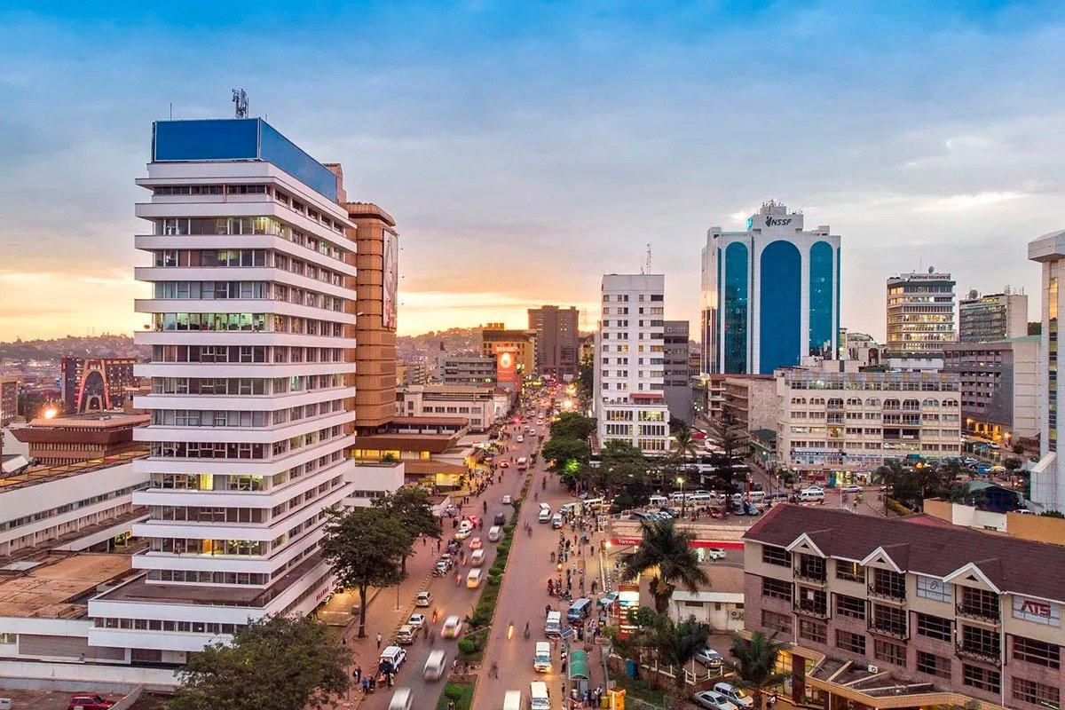
CLOSE
2 February 2027.
Kampala only.
sharp@realsalogistics.com · @realsalogistics
If day 45 misses, we cut media. We do not expand the map.
Real Estate Africa SA Logistics · Kampala launch · Confidential
12 / 12

