Slide 1
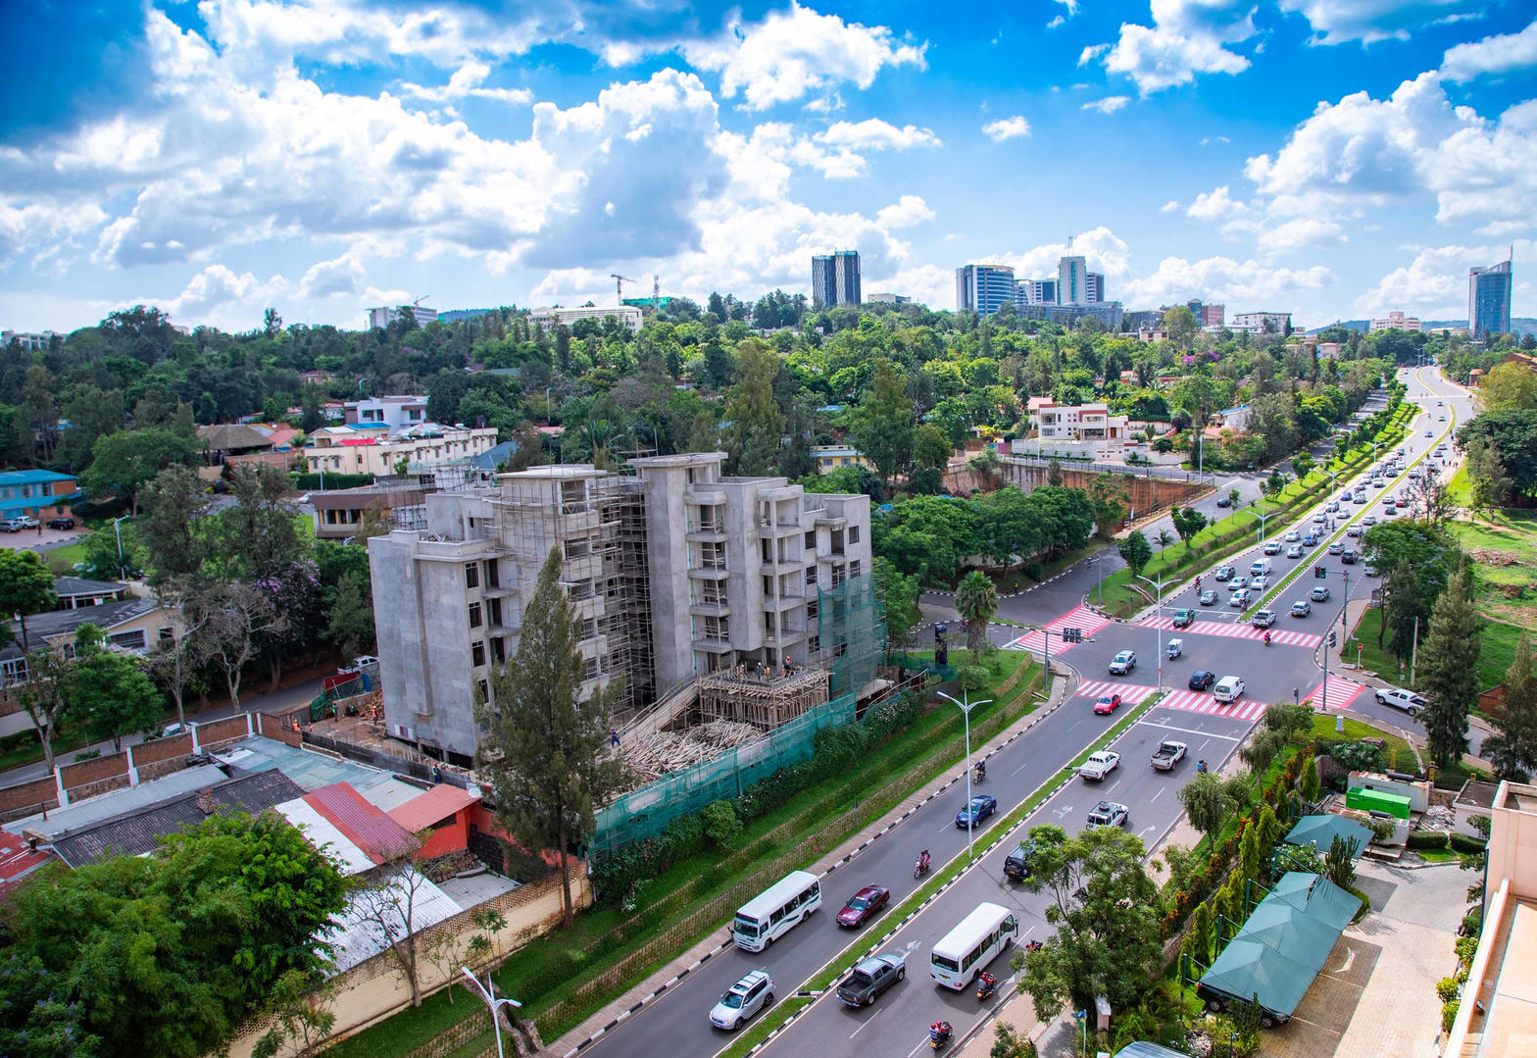
MARKET PACK · WAVE 6 · NOVEMBER 2027
Thin presence.
Real corridor.
Bujumbura and the lake. Spend like a corridor, not a capital campaign.
Wedge: concession literacy + Lake Tanganyika compounds.
Real Estate Africa SA Logistics · Burundi · Confidential
1 / 10

Slide 2
WHY
Why Burundi is on the 2027 map
– The commercial logic is the lake and the road to Kigali/Dar — not a second Nairobi.
– A live flag with 30 honest listings beats a fake national footprint.
– French + Kirundi creative. English third.
Real Estate Africa SA Logistics · Burundi · Confidential
2 / 10

Slide 3
LAW ON THE CARD
Tenure language we will actually print
– Concession / occupancy language — not mailo, not Kenyan freehold.
– Occupant unknown is allowed; 'clean' is not.
– Foreign ownership — flag for counsel on every close.
– Payments: card first until MoMo reliability is measured.
Not legal advice. Local counsel on every close.
Real Estate Africa SA Logistics · Burundi · Confidential
3 / 10

Slide 4
GEOGRAPHY
Where we spend — and where we wait
City | Role | Wave
Bujumbura | Only Wave 6 city | Nov 2027
Interior | Hold | 2028 review
Real Estate Africa SA Logistics · Burundi · Confidential
4 / 10

Slide 5
CHANNELS
How this market hears us
– Lake-side viewing days, not billboards.
– Kigali and Dar agency referrals.
– Facebook + WhatsApp. Radio only if CAC allows.
– Budget cap: 20% of Kampala Wave 1. No more.
Real Estate Africa SA Logistics · Burundi · Confidential
5 / 10

Slide 6
SCOREBOARD
Targets after spend opens
KPI | 90 days | Note
Paying seats | 30 | Success is thin and true
Live listings | 40 | Bujumbura only
Lake / corridor quotes | 12 | The SKU
Spend | ≤ $3,600 | 20% of Kampala 90-day
Real Estate Africa SA Logistics · Burundi · Confidential
6 / 10

Slide 7
OFFER
What we push first
Demand
Supply
– Buyer Explore free — fill the top of funnel.
– Diaspora Plus $10 — remote buyers.
– Enterprise $199 only where a developer is named.
– Agent Starter $9 until the room is used to us.
– Agency Pro $49 as the default agency seat.
– Logistics Partner $69 where a corridor exists.
Real Estate Africa SA Logistics · Burundi · Confidential
7 / 10

Slide 8
HOLD
Do not
– Do not spend like Nairobi. Do not copy Uganda legal fields. Do not promise a national map.
– Do not invent a second brand film.
– Do not discount the public price card.
– Do not go live on a listing with empty tenure.
Real Estate Africa SA Logistics · Burundi · Confidential
8 / 10

Slide 9
PAIRING
Always ship with a move
– Every featured listing has a freight or household quote path.
– Corridor stories beat city pride: Kampala–Malaba, Mombasa–Kampala, Dar–Kigali, lake.
– SLA: quote in < 4 hours in the live city, < 1 business day otherwise.
Real Estate Africa SA Logistics · Burundi · Confidential
9 / 10

Slide 10

CLOSE
Burundi.
Precise, or not at all.
Real Estate Africa SA Logistics · sharp@realsalogistics.com · @realsalogistics
Real Estate Africa SA Logistics · Burundi · Confidential
10 / 10

